Slide 1
ANTELI
2020
Silicon carbide material

Slide 2
ABOUT US
01
Provide youthe best product cooperation program
关于我们

Slide 3
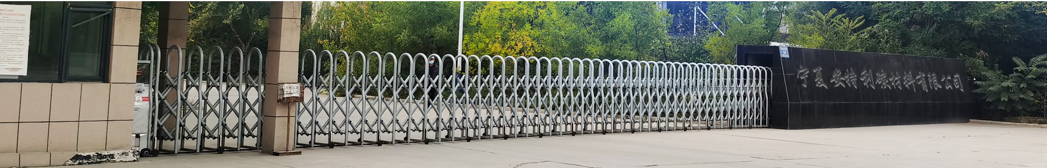


COMPANY
The company was founded in November 2011 with a registered capital of 15 million yuan
and is located in Hongguo Industrial Park, Huinong District, Shizuishan City.
Our company is specialized in the production of four high (high density, high crystallization,
high purity, high uniformity) black silicon carbide factory, has its own deep processing workshop
two production lines.
The establishment of four roller black silicon carbide production line, the product output can reach
70,000 tons per year.Today, 35,000 tons of production lines and supporting deep processing workshops have been put into production.
Our company has the domestic advanced production line of silicon carbide particle size sand,
silicon carbide powder production line, silicon carbide ceramic products production line,
Silicon carbide micro - powder channel reactor production line and related core intellectual property
rights to produce different specifications of section sand, mesh sand, fine powder and ultrafine powder.
Can meet the needs of different customers.With anthracite as smelting raw material, silicon carbide
products have low ash content, low sulfur, low phosphorus, high calorific value,
High mechanical strength, high chemical activity, high specific resistance and other characteristics,
is the world's highest quality level of silicon carbide products.The product is widely used in abrasive
products refractory, deoxidizer used in iron and steel bonding anti-slip materials, petrochemical,
dust chemical industry and other industries.In mining metallurgy, metal, furnace, machinery,
iron and steel, energy, environmental protection, electronics, semiconductor, aerospace,
automobile and other industries, silicon carbide new technology in Rico optical materials,
thin film materials, radiation resistance devices, high temperature pressure sensors, ultra-high
pressure detectors and other fields show a wider application prospect.
Our company always adhere to the business philosophy of "based on integrity, innovation and
development", to provide our customers with quality services and excellent products.
We would like to be your most reliable partner.
公司成立于2011年11月注册资金1500万元，位于石嘴山市惠农区红果子工业园。
我公司是专业生产四辊(高密度、高结晶、高纯度、高均匀性)黑碳化硅的工厂，有自己的深加工车间两条生产线。
四辊黑碳化硅生产线的建立，产品输出可以达到每年7万吨。如今，3.5万吨生产线和配套的深加工车间已投产。
我公司拥有国内先进的碳化硅粒度砂生产线，碳化硅微粉生产线、碳化硅陶瓷制品生产线，
碳化硅微粉通道反应器生产线等以及相关核心知识产权，生产不同规格的段砂、网砂、细粉和超细粉。
可满足不同客户的需要。以无烟煤为冶炼原料，生产的碳化硅产品具有低灰分、低硫、低磷、高热值、
高机械强度、高化学活性、高比电阻等特点，是世界上质量水平最高的碳化硅产品。该产品广泛应用于磨料制品中的耐火材料，脱氧剂用于钢铁的粘结防滑材料，石油化工、粉尘化工等行业。在矿山冶金、金属、窑炉、机械、钢铁、能源、环保、电子、半导体、航天、汽车等行业中，碳化硅新技术在利科光学材料、薄膜材料、抗辐射器件、高温压力传感器、超高压探测器等领域展现出更广泛的应用前景。
我公司始终秉持“诚信立足、创新致远”的经营理念，为广大客户提供优质的服务和质量过硬的产品，
愿成为您最可信赖的合作伙伴。

Slide 4
Equipment & production line
02
生产设备和生产线

Slide 5
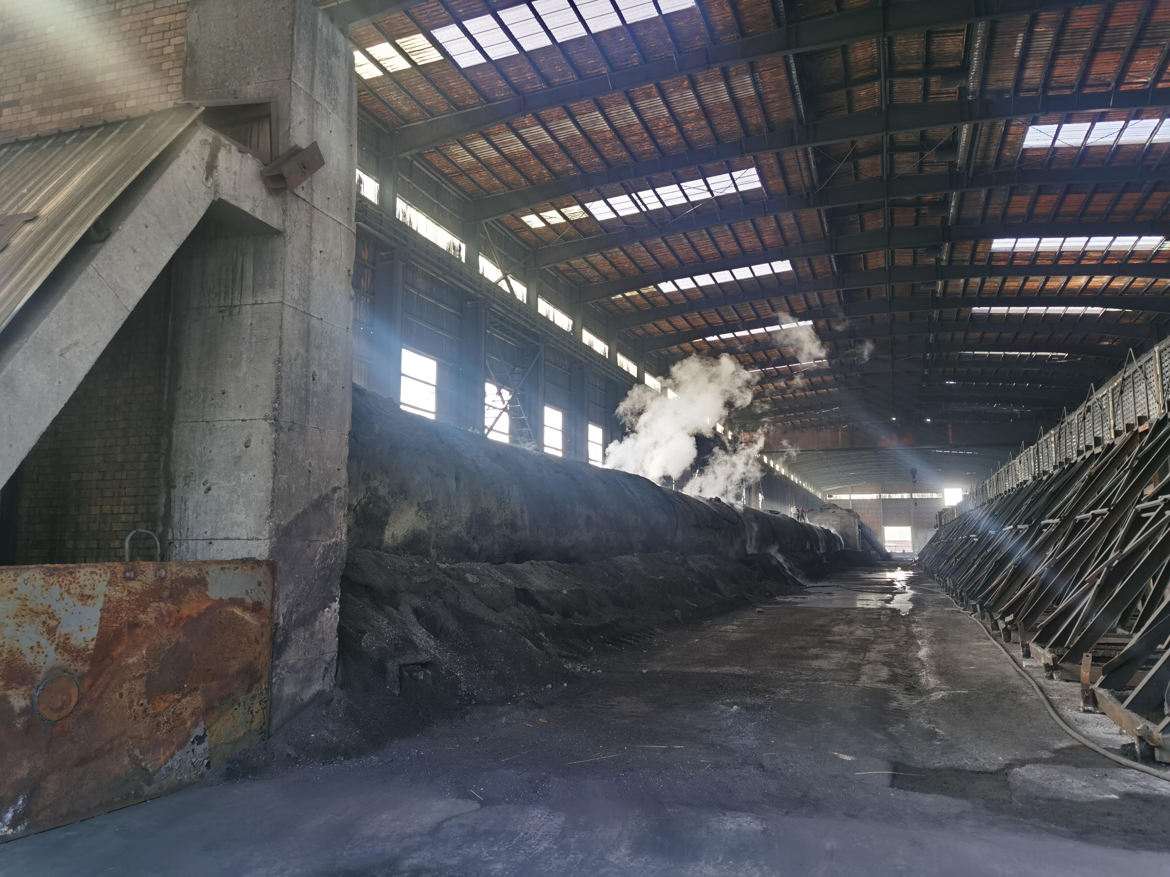
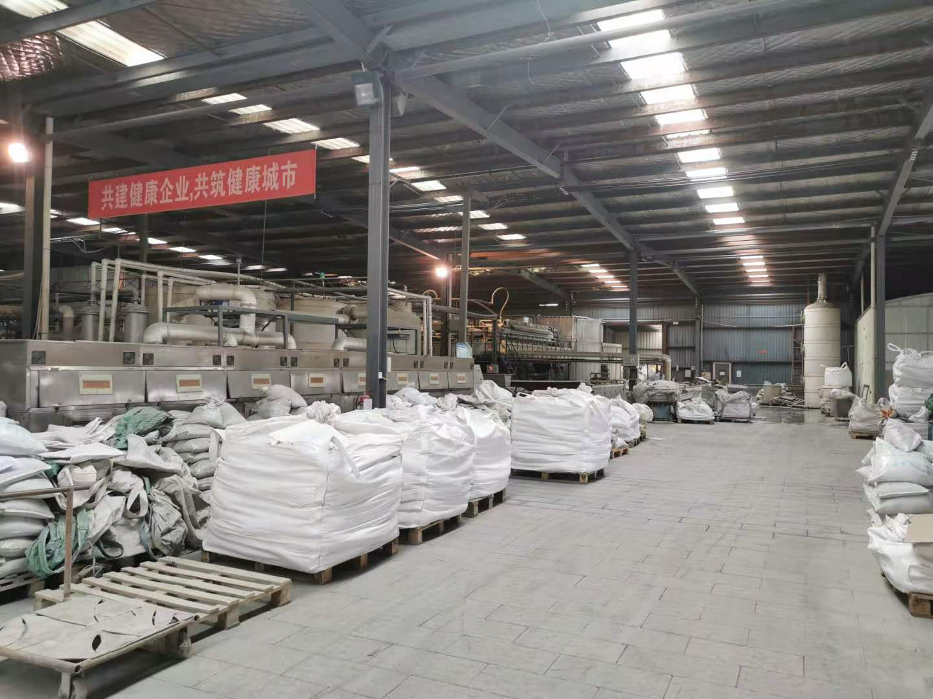
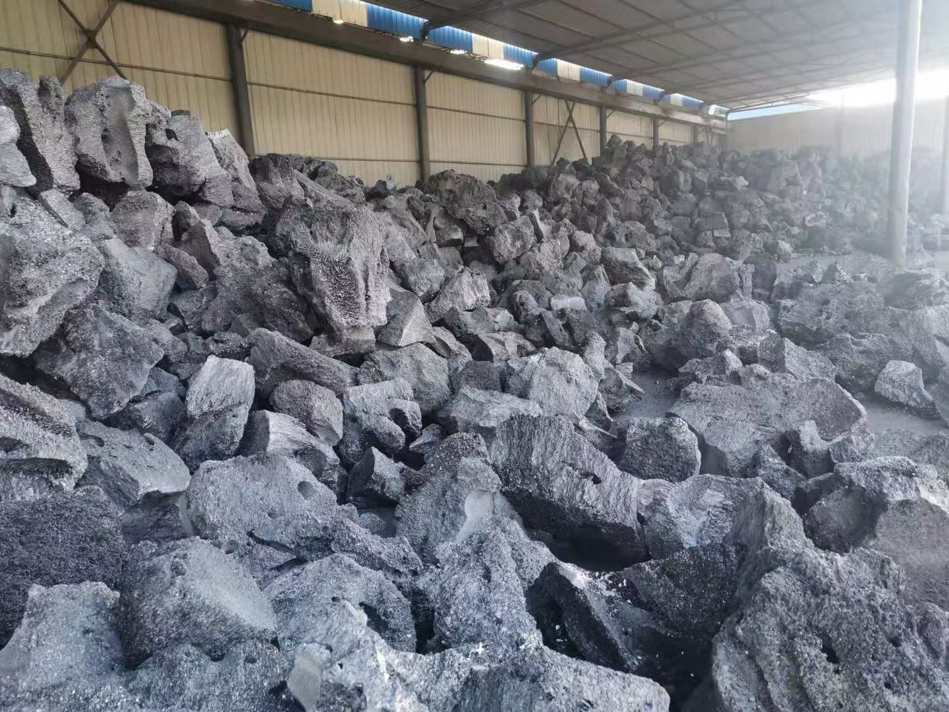
Full view of smelting furnace
冶炼炉全景
Micro powder processing workshop
High density large crystalline silicon carbide
微粉加工车间
高致密大结晶碳化硅

Slide 6
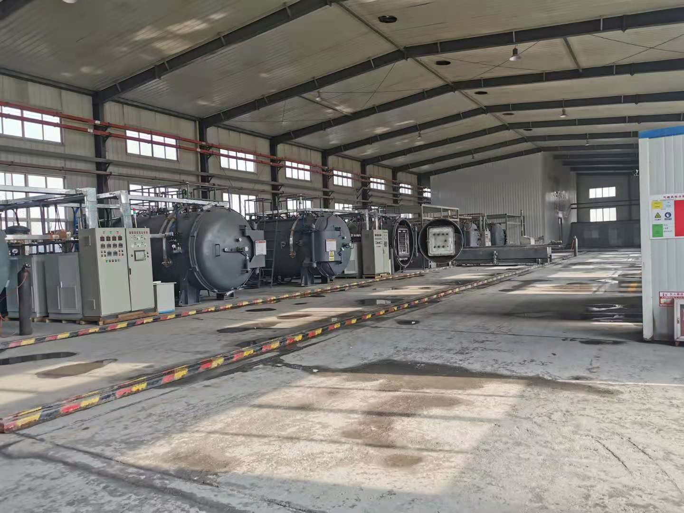
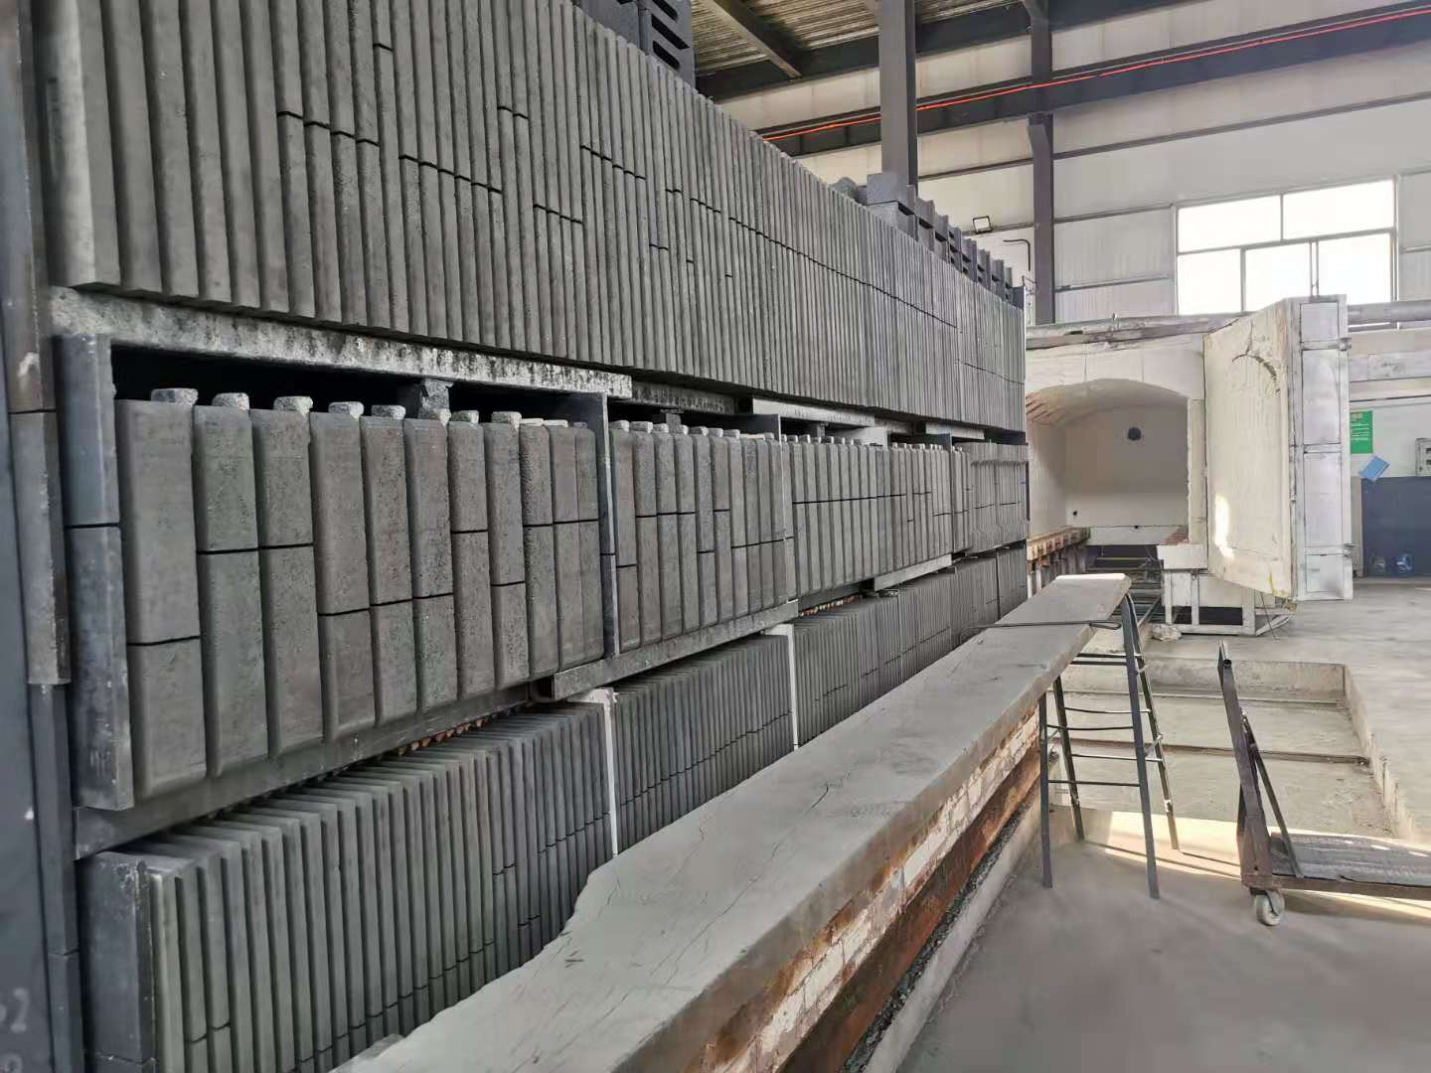
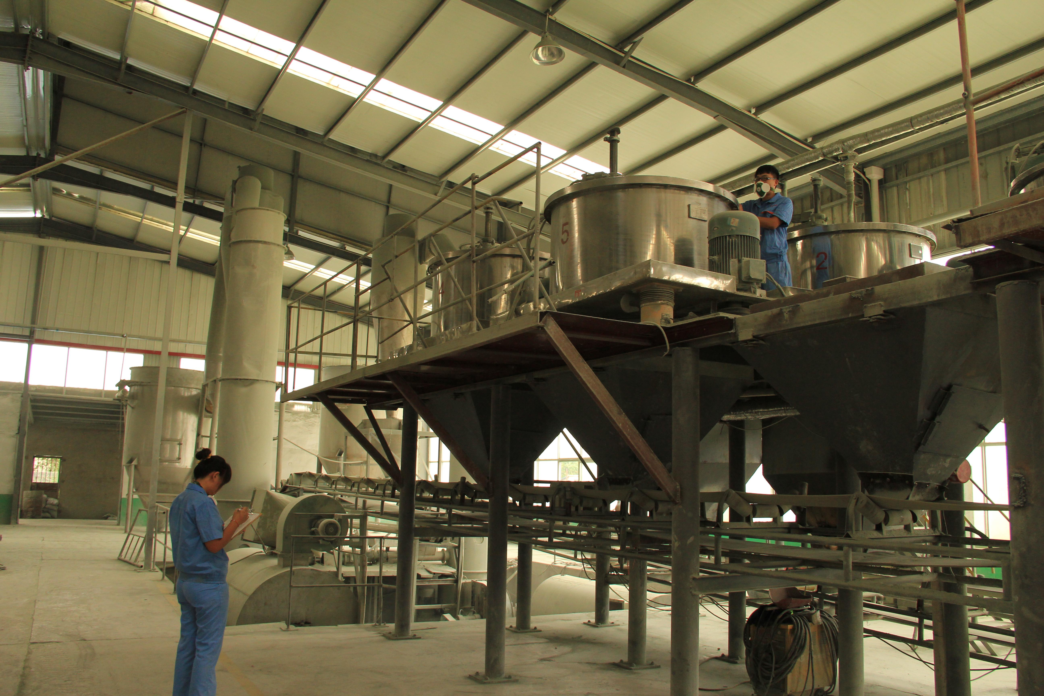
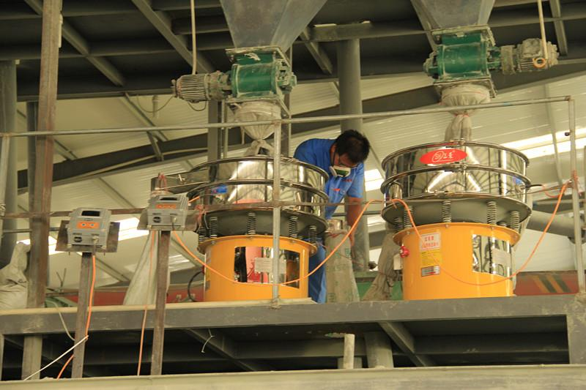
Non-pressure sintered silicon carbide workshop
无压烧结碳化硅车间
Sintered boron carbide plate
碳化硅硼板烧结

Slide 7
Product seriation
03
SILICON CARBIDE INDUSTRIAL LEADER
产 品 系 列

Slide 8
Products series
CONTENTS
01
Silicon carbide
02
Ceramic powder &Sic powder
03
Granulated powder
04
Batts

Slide 9
Products series
CONTENTS
05
Beams and Supports
06
Roller
07
Cooling air pipes
08
Burner Nozzles

Slide 10
Products series
CONTENTS
09
Wear sleeves, Tube
10
Canti levers paddles
11
Solid beam pole
12
Radiant tube and Heat Exchangers

Slide 11
Products series
CONTENTS
13
Desulphurization nozzles
14
Special Parts
15
SSiC Properties
16
Bulletproof product profile

Slide 12
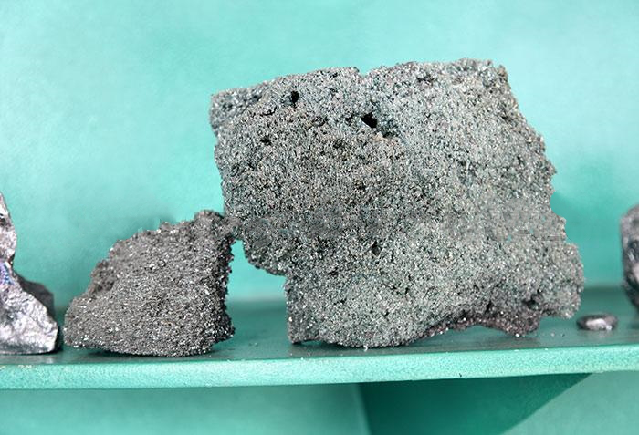
Ultra-crystalline Fine Powder
Previous Page :Solid beam , pole
Next :Ultra-crystalline Fine Powder
Name: Ultra-crystalline Fine Powder
These products are used as loading frames in porcelain producing kilns,
and which can replace normal oxide bonded silicon plate and mullite post as
they have good advantages like save spaces ,fuel ,energy and also short the firing time,
and the life time of this materials is several times of others, it is very ideal kiln furniture.The natural bulk density of silicon carbide abrasive is within 1.2 to 1.6g/mm3,
and the proportion is between 3.20 and 3.25. The main raw materials of green silicon carbide are petroleum coke and high-quality silica, and green silicon carbide is
used as an additive by adding salt and is made by smelting in resistance furnace at high temperatures. The hardness is between corundum and diamond,
and the mechanical strength is higher than that of corundum. There shall be no large particles in fine powder, and in order to meet the requirements of international
and domestic products, generally, JZF grading equipment is adopted in production for high-precision classification.
01

Slide 13
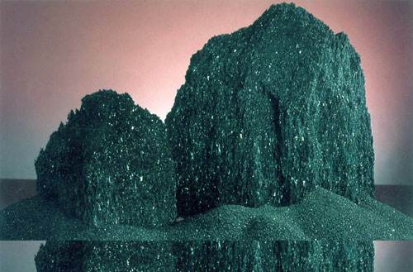
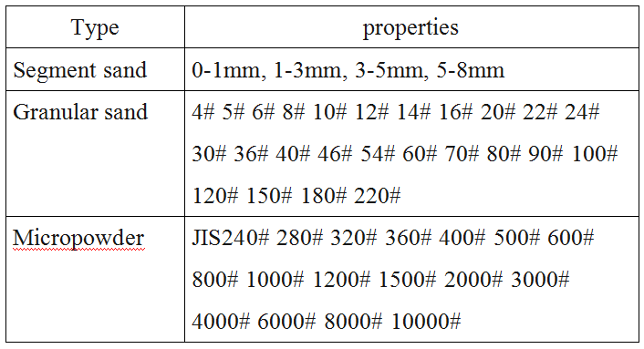
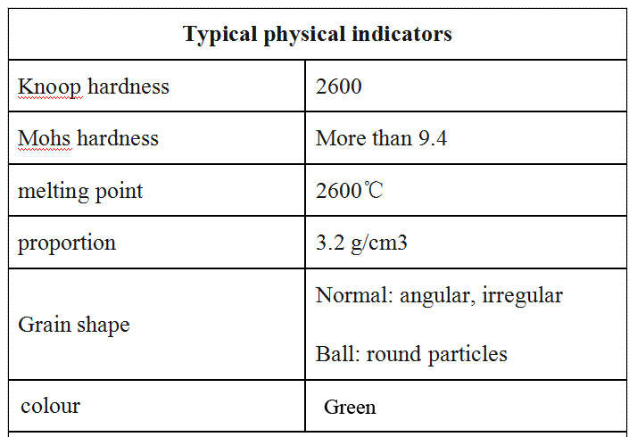
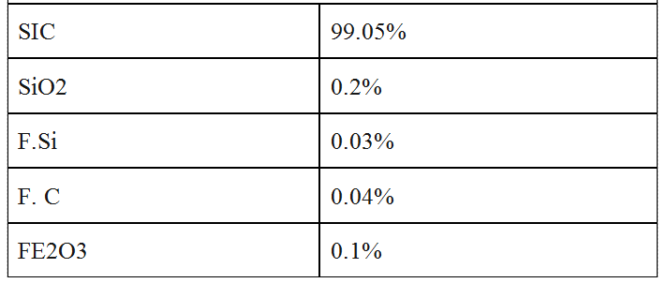
Green Silicon Carbide
Product model and use
Physical and chemical indicators
Typical chemical indicators
The green silicon carbide segment sand is produced by Bama restraint sand machine, with rounded particles. As the grinding medium, it can perfectly replace the high price zirconia ball.
In the ultra-fine powder grinding of green silicon carbide photovoltaic edge material, it has perfect grinding effect and does not affect the product content Green silicon carbide grain size sand is mainly
used for abrasive manufacturing and sand blasting media for surface treatment. Manufacturing of grinding tools: resin grinding wheel, ultra-thin cutting piece, marble grinding wheel, diamond grinding plate, etc
Surface treatment: grinding hard alloy, hard brittle metal and non-metallic materials - quartz glass, optical glass, piezoelectric ceramics, etc.
Green silicon carbide powder can be used for precision grinding of hard glass, slice of single crystal silicon and polycrystalline silicon bar, precision grinding of single crystal silicon chip,
processing of super hard metal, processing of soft metal such as copper and copper alloy, processing of various resin materials, etc.
Product description
Green silicon carbide is made of petroleum coke and high-quality silica by high-temperature smelting in resistance furnace with salt as additive. It is green crystal, brittle and sharp,
and has certain thermal conductivity and conductivity. The microhardness of silicon carbide is 9.3, the microhardness of silicon carbide is 2940-3300kg / mm2, the Knoop hardness is 2670-2815kg / mm2,
which is higher than that of corundum in abrasives, and next to diamond, CBN and BCC. The density is generally considered as 3.20-3.25g/cm3. The natural packing density of silicon carbide abrasive is
between 1.2-1.6g/cm3, and the specific gravity is 3.20-3.25g/cm3.
Green silicon carbide micro powder is made of high-quality large crystalline silicon carbide block by crushing, vertical ball mill particle shaping, acid pickling water, precise hydraulic classification,
high-temperature drying after natural settlement, stable quality, good crystallization, high surface cleanliness, no large particles, small content of fine particles, concentrated particle size distribution,
high grinding efficiency, suitable for all kinds of precision grinding processing, uniform surface of processed workpiece , no scratches.
Green silicon carbide spherical sand and micro powder are the second shaping products after Raymond grinding. They have the characteristics of small particle edges and corners, good hydrophilicity,
high grinding efficiency and long working life.
01

Slide 14
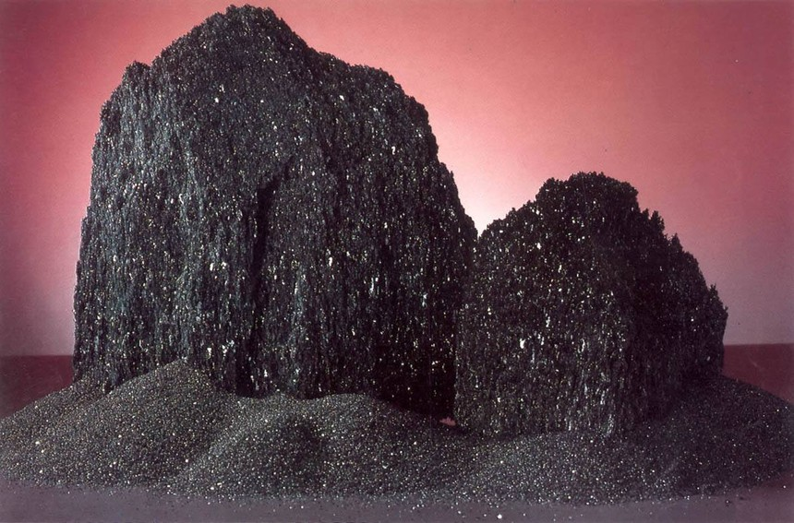
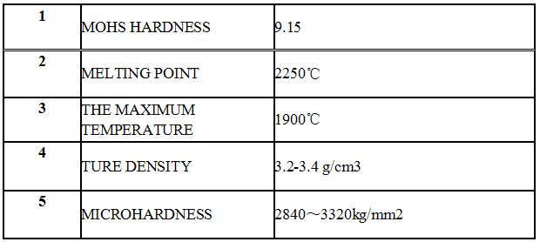
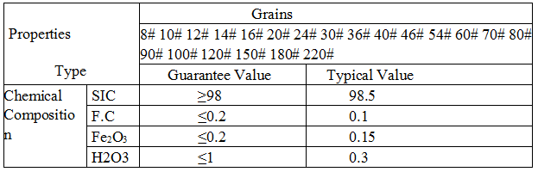
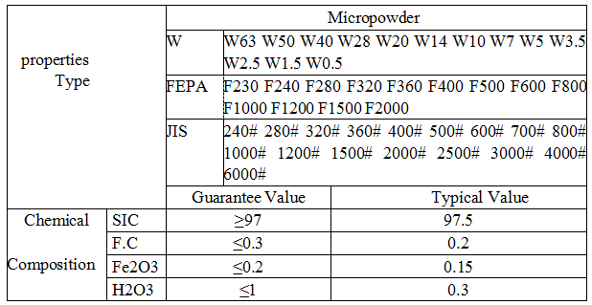
Black Silicon Carbide
Product description
Performance features: black silicon carbide is made of quartz sand, petroleum coke (or coal coke), sawdust and other
raw materials by high-temperature smelting in the resistance furnace, and by high-temperature smelting in the resistance furnace,
which is black opaque, hexagonal crystal, Mohs hardness of 9.15. Second only to diamond and boron carbide, it is brittle, sharp
and conductive
Physicochemical properties
Grain size
Micro powder specifications
Product use
1. Abrasives: mainly used for grinding wheel, sandpaper, oilstone, grinding head, grinding paste, monocrystalline silicon, polycrystalline
silicon in photovoltaic products and surface grinding and polishing of various devices.
2. High grade refractory: it can be used as metallurgical deoxidizer and high temperature resistant material to make high temperature furnace components, supporting parts, etc.
3. Functional ceramics: it can not only reduce the capacity of kiln tools, but also improve the quality of kiln products and shorten the cycle.
It is an ideal indirect material for baking and sintering of ceramic glaze, high temperature non oxide ceramics and reaction sintering ceramics.
4. Non ferrous metals: Iron and steel industry, metallurgy and mineral processing industry, have been applied.
01

Slide 15
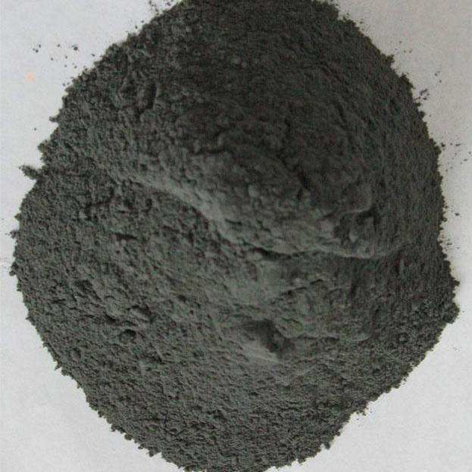
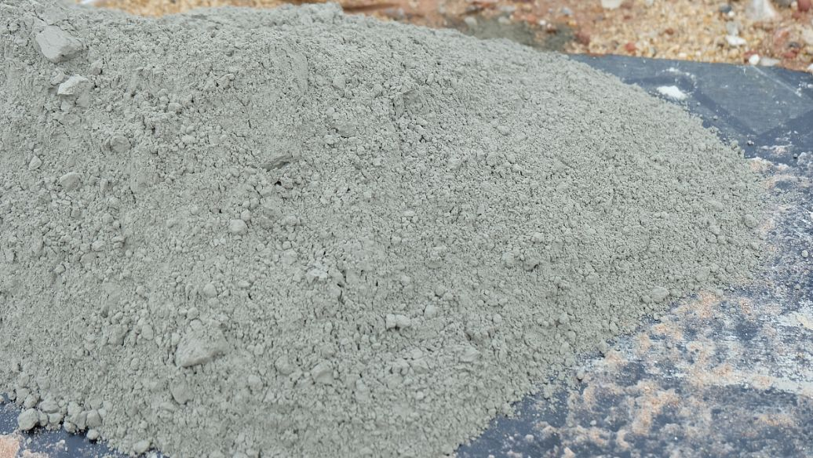
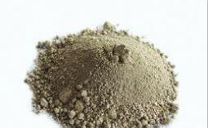
Ceramic powder
Our company of silicon carbide ceramic material with silicon carbide powder, using the obtained
national patent technology production, the use of special optimum seeking method of interception
of silicon carbide crystals in most alpha silicon carbide crystals, polycrystalline silicon carbide density
is highest, 2200 degrees or more long time smelting silicon carbide crystals of raw material
to produce, the second-stage above 1.6 to 1.8 g/cm3 density, more than 99.9% purity.
The density of non-pressure sintered silicon carbide ceramics is above 3.16g/cm3 to achieve and
exceed the quality of international silicon carbide powder.
02

Slide 16
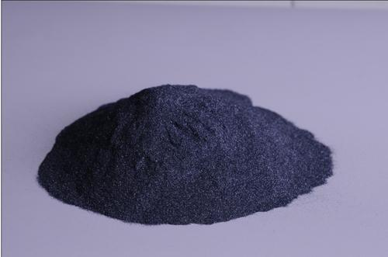
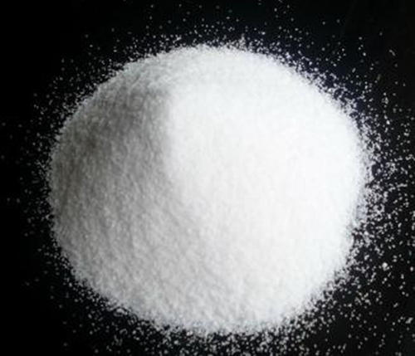
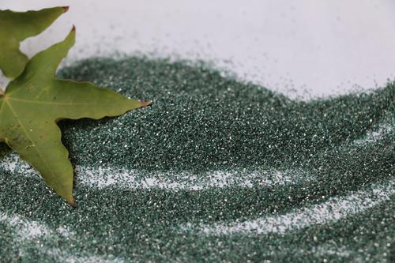
Sic powder
Our company USES JZFZ equipment for ultrafine grinding of micron grade sic powder.
Silicon carbide powder is mainly used in 1200# and 1500#. Since silicon carbide powder is mainly used in
abrasive industry, there are special requirements for the classification of the powder, and no large particles
can be found in the powder. Therefore, in order to meet the requirements of international and domestic products,
JZF classification equipment is used for high precision classification.Silicon carbide powder is mainly black silicon
carbide powder and green silicon carbide powder.
The main standards of silicon carbide powder are: national standard, Japanese standard, European standard.
Our export to gb, Japanese standard - based.
02

Slide 17
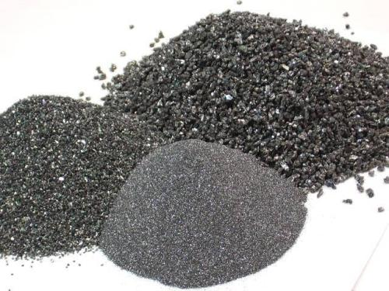
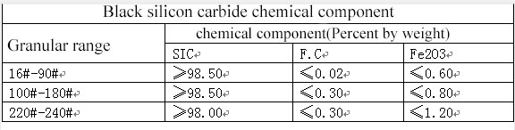
Granulated powder - black
Black silicon carbide is quartz (SIO2) and anthracite coal or petroleum coke (C) as the basic raw material under the condition of over 1800 degrees centigrade high temperature generated by the non-metallic minerals, it has high hardness, small expansion coefficient, crisp, good thermal conductivity, is widely used in abrasives and grinding of electronic products, refractory materials, special ceramics, ceramic foam, coating modified plastic additives, auto parts, military aviation, steelmaking deoxidizer, etc.
黑碳化硅是以石英砂(SIO2)和无烟煤或石油焦(C)为基本原料在摄氏1800度以上高温条件下生成的非金属矿产品,它具有硬度高,膨胀系数小,性脆,导热性好等特点,广泛应用于磨料磨具,电子产品研磨,耐火材料,特种陶瓷,泡沫陶瓷,涂料塑料添加改性,汽车配件,军工航空,炼钢用脱氧剂等。
03

Slide 18
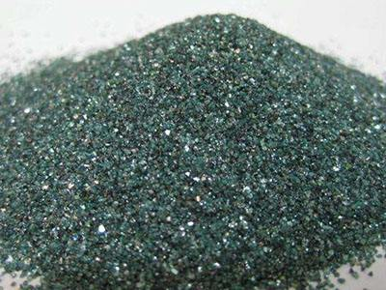
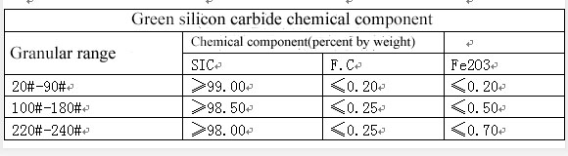
Granulated powder - Green
Green silicon carbide is a non-metallic mineral product produced by quartz sand (SIO2), petroleum coke (C) and sodium chloride (NACL) as the basic raw materials under the high temperature conditions above 1800 degrees Celsius. It is characterized by high hardness, small coefficient of expansion, brittle properties and good thermal conductivity.It is widely used in abrasives, abrasives, electronic products, refractories, special ceramics, coating plastics, grinding wheels, cutting pieces, auto parts, military aviation and so on.
绿碳化硅是以石英砂(SIO2)和石油焦(C)及氯化钠(NACL)为基本原料在摄氏1800度以上高温条件下生成的非金属矿产品,它具有硬度高、膨胀系数小、性脆、导热性好等特点。广泛应用于磨料磨具、电子产品研磨、耐火材料、特种陶瓷、涂料塑料添加改性、制作砂轮，切割片，汽车配件、军工航空等。
03

Slide 19
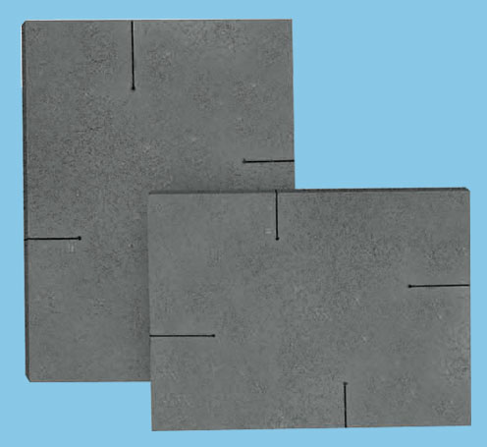
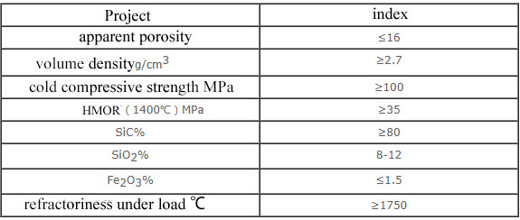
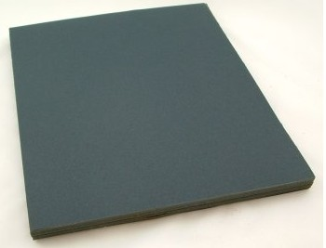
Batts
This product is suitable for kiln furniture and burning plat of
industrial kin.
碳化硅板
该产品适用于工业窑炉的窑具、承烧板
产品特性：
1.以上各项技术特色优强：
2.高温下尺寸稳定，抗变形，高温强度高；
3.抗热冲击，耐磨损，高温抗侵蚀；
4.抗氧化，抗化学侵蚀，抗老化；
5.导热度高；
Product features:
1. Excellent technical features of the above:
2. Stable size, deformation resistance and high strength at high temperature;
3. Thermal impact resistance, wear resistance, high temperature erosion resistance;
4. Anti-oxidation, anti-chemical erosion, anti-aging;
5. High thermal conductivity;
04

Slide 20
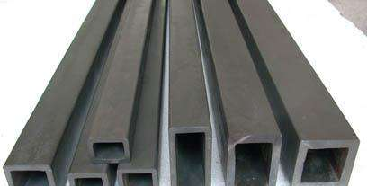
05
Beams and Supports
横梁、立柱
The product has excellent high temperature flexural strength, thermal shock resistance, oxidation resistance, large bearing capacity, long-term use without deformation, suitable for shuttle kiln, tunnel kiln, double roller kiln and various high temperature kiln load-bearing structure frame.The beam has good thermal conductivity, long service life, energy saving and consumption reduction.
该产品具有优异的高温抗折强度、抗热震、抗氧化性、承载力大，长期使用不变形，适用于梭式窑、隧道窑、双层辊道窑及各种高温窑炉的承重结构架。横梁具有良好的热传导性，且使用寿命长，节能降耗。
long （m） | Size of Section (mm) 截面尺寸 |  |  | Concentrated loading(kg) | Uniformly
L | B | H | S | 集中力 | 均布力合力
1 | 30 | 40 | 6 | 130 | 260
1 | 40 | 40 | 6 | 165 | 330
1 | 40 | 50 | 6 | 235 | 470
1 | 50 | 60 | 7 | 414 | 828
1 | 50 | 70 | 7 | 526 | 1052
1 | 60 | 90 | 9 | 1059 | 2118

Slide 21
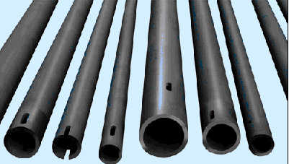
Roller
辊 棒
06
The product has excellent high temperature flexural strength, oxidation resistance, strong wear resistance, long-term high temperature use without breaking, bending and other characteristics.It is suitable for high-temperature firing of roller kilns for daily porcelain, sanitary porcelain, building porcelain, magnetic materials, etc.The service life is several times that of other materials.
该产品具有优异的高温抗折强度、抗氧化性、极强的耐磨性，长期高温使用不断裂，不弯曲等特点。适用于日用瓷、卫生瓷、建筑瓷、磁性材料等辊道窑高温烧成带。使用寿命是其它材质的几倍。
long （m） | Size of Section (mm) 截面尺寸 |  |  | Concentrated loading(kg) | Uniformly
L | D₁ | D₂ | δ | 集中力 | 均布力合力
1 | 35 | 23 | 6 | 70 | 140
1 | 40 | 28 | 6 | 97 | 194
1 | 45 | 33 | 6 | 130 | 260
1 | 50 | 38 | 6 | 167 | 334
1 | 55 | 44 | 7 | 261 | 522
1 | 60 | 46 | 7 | 283 | 566
1 | 80 | 46 | 8 | 604 | 1208

Slide 22
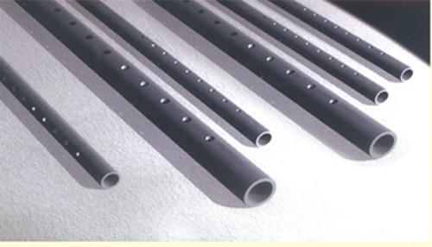
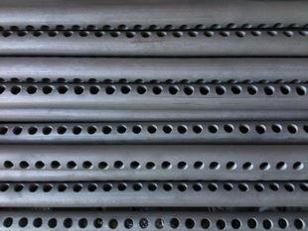
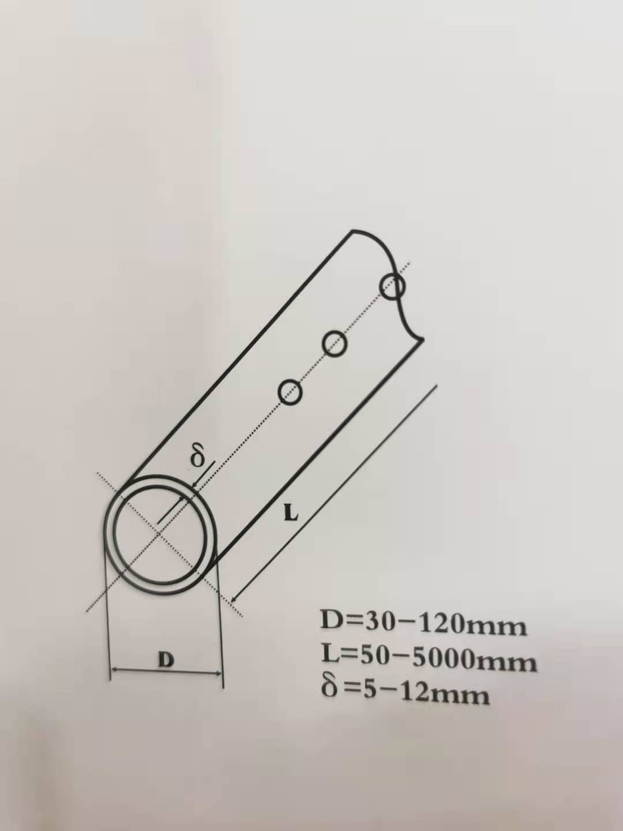
Cooling air pipes
冷风管
07
The product has good thermal stability, thermal shock resistance, oxidation resistance, high temperature creep resistance, high temperature cold wind impact resistance, long-term use without bending and deformation, service life is several times that of other materials
该产品热稳定性好、抗热震、抗氧化、抗高温蠕变，在高温下耐急冷风冲击，长期使用不弯曲不变形，使用寿命是其它材质的几倍

Slide 23
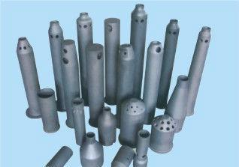
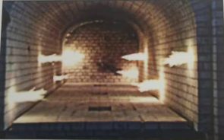
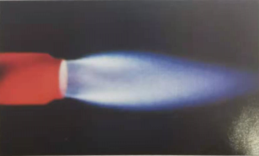
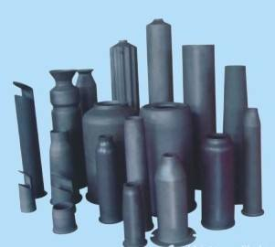
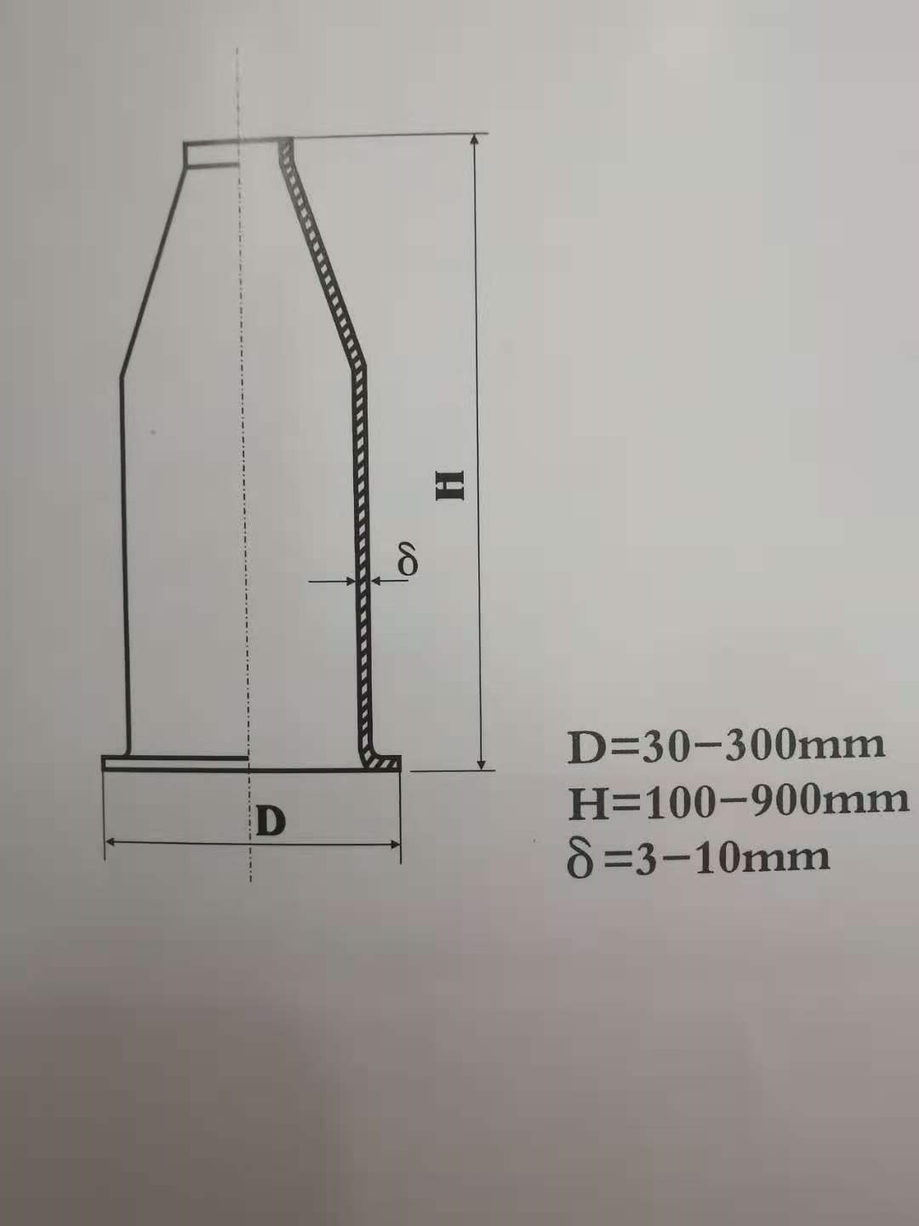
Burner Nozzles
喷火嘴
This product is the tunnel kiln, shuttle kiln, roller kiln ideal spray fire kiln furniture. RBSIC(SISIC) Burner nozzles are the most suitable kiln furnitures of tunnel kilns, shuttle kilns, roller of hearth kilns as the flame tubes.
该产品是隧道窑、梭式窑、辊道窑的理想喷火窑具。
08

Slide 24
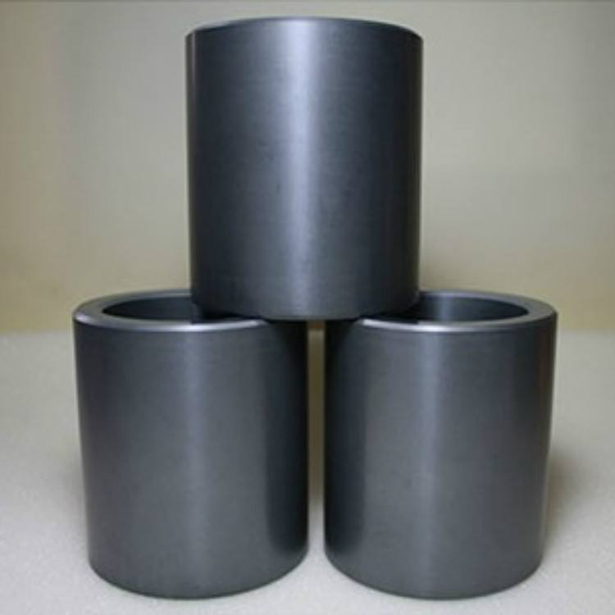
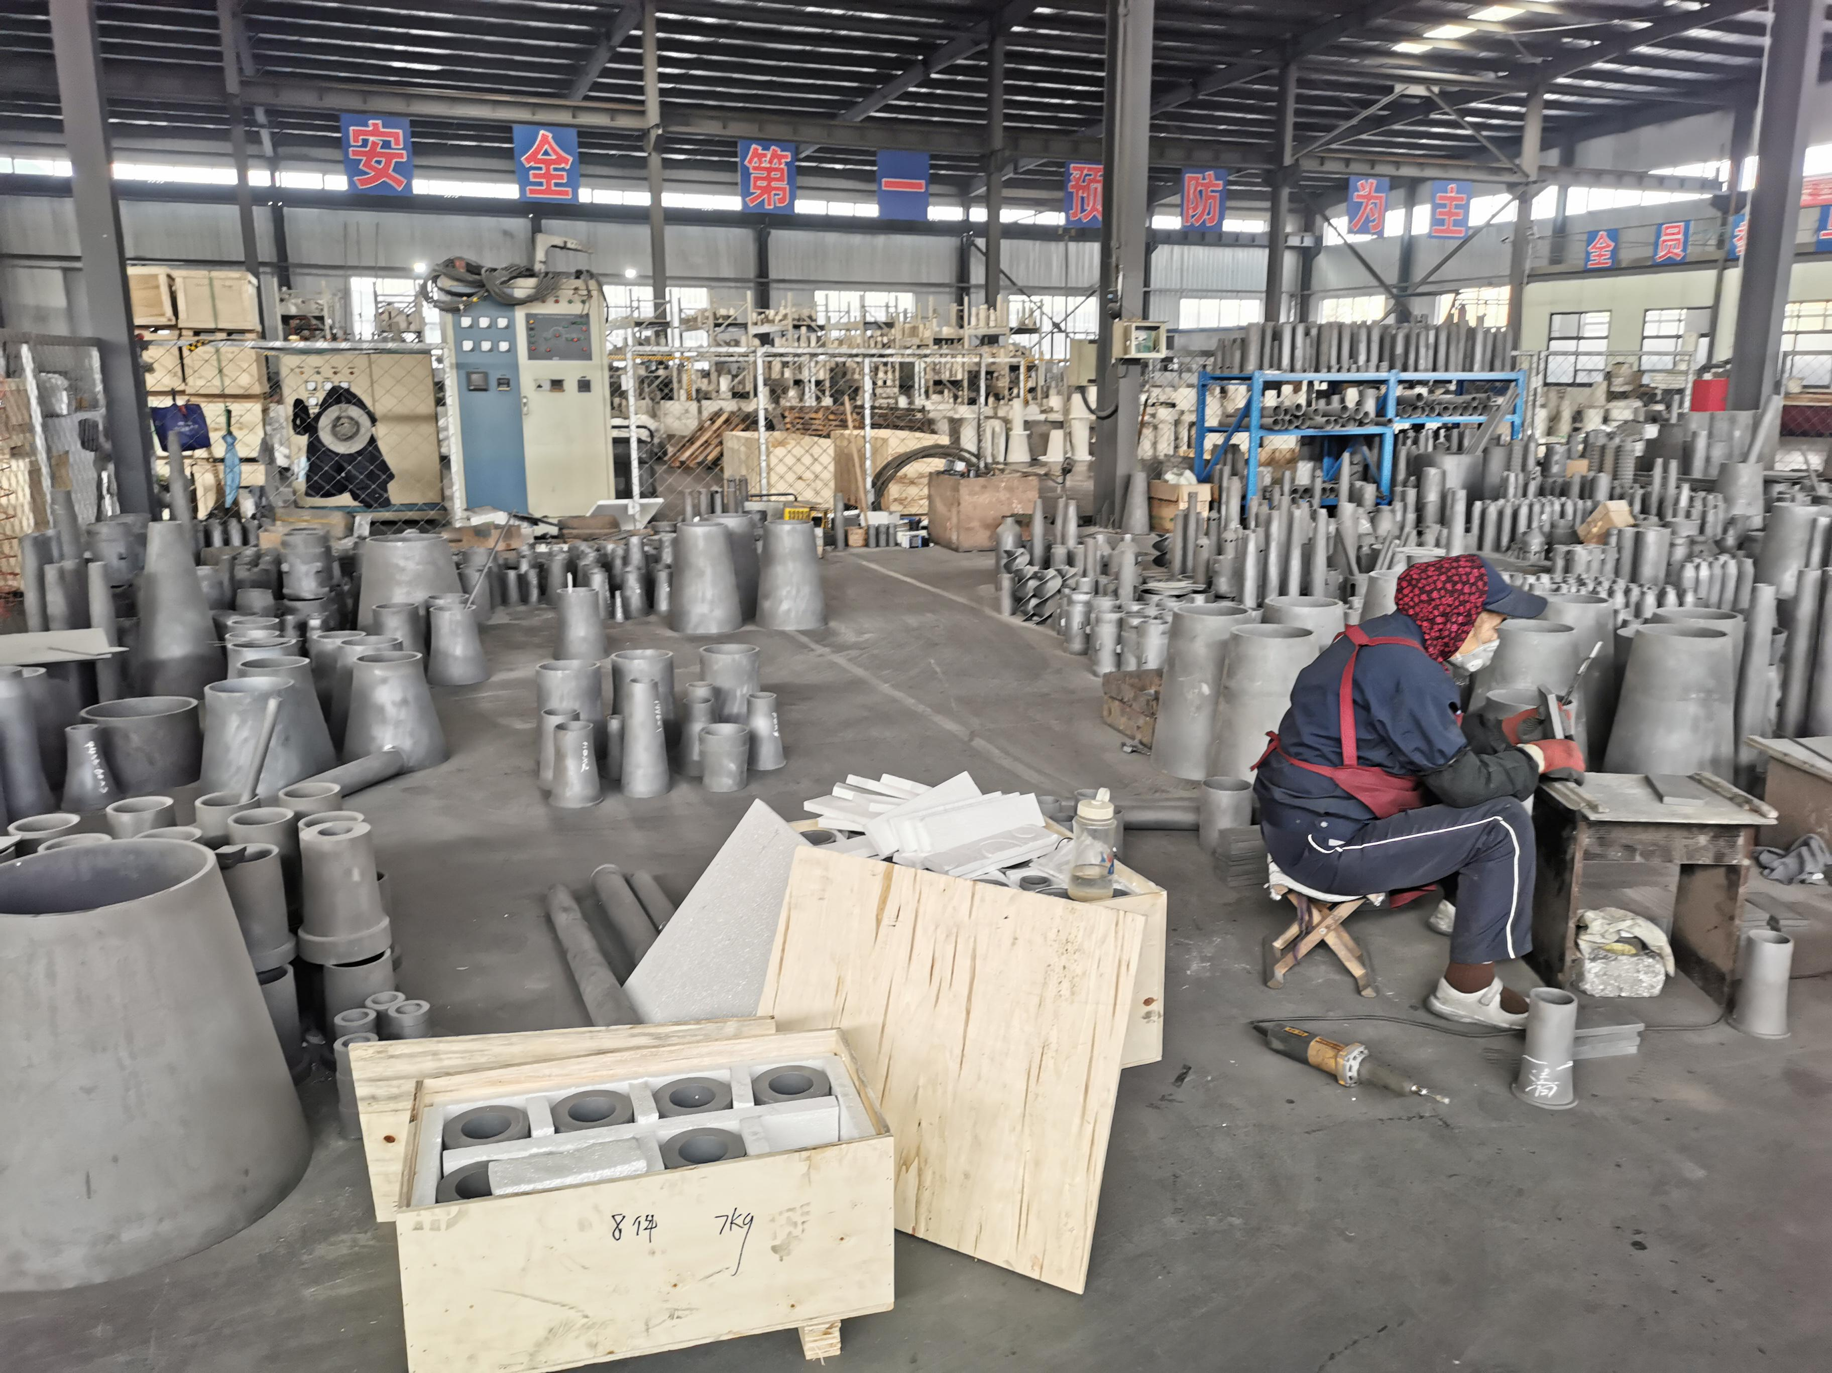
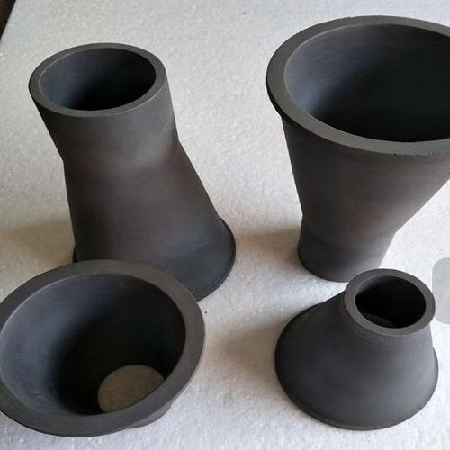
Wear sleeves, Tube
耐磨套、管
The product has the characteristics of high strength and high wear resistance and is widely used in paper making, chemical electronics, medicine and other fields, such as inkjet, lithium electric material, electronic paste, nano ceramic grinding machine, etc
该产品具有高强度、高耐磨的特性被广泛应用于喷墨、锂电材料、电子浆料、纳米陶瓷磨砂机等造纸、化工电子、医药等领域.
09

Slide 25
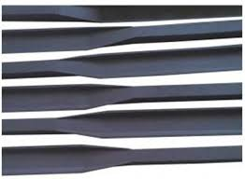
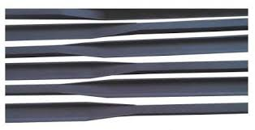
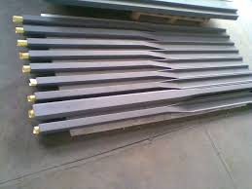
Canti levers paddles
悬臂浆
Reactive sintered silicon carbide cantilever slurry is a key component of semiconductor wafer loading system.The cantilever slurry has stable performance, no deformation in high temperature environment, and large wafer loading capacity. It is suitable for automatic loading and handling system of robot.Because the cantilever slurry section is stable and does not deform, it is possible to use the existing furnace control to prepare larger wafers.The thermal expansion coefficient of cantilever slurry is similar to that of LPCVD coating. When applied to LPCVD, the maintenance and cleaning cycle is greatly extended and pollutants are greatly reduced.
反应烧结碳化硅悬臂浆，是半导体晶圆装载系统的关键部件。悬臂浆性能稳定，在高温环境不变形，晶圆装载量大，适用于机器人自动装载和搬运系统。由于悬臂浆截面稳定不变形，使得利用现有的炉管制备更大规格晶圆成为可能。悬臂浆与LPCVD涂层的热膨胀系数相近，应用于LPCVD，极大地延长了维护清洗周期，并大幅减少污染物。
10

Slide 26
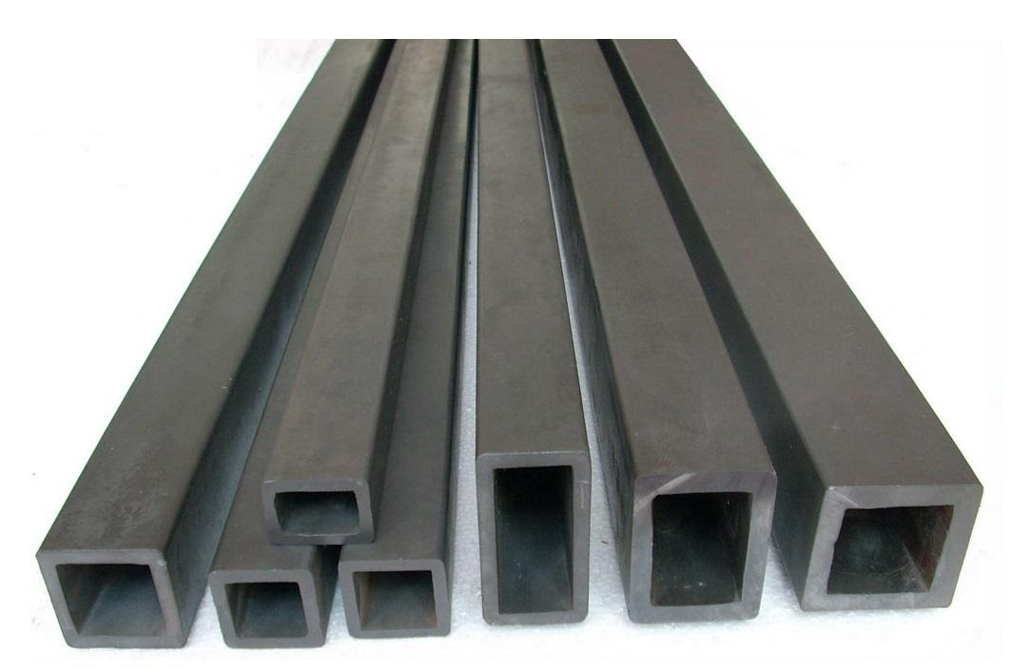
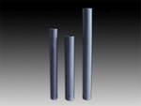
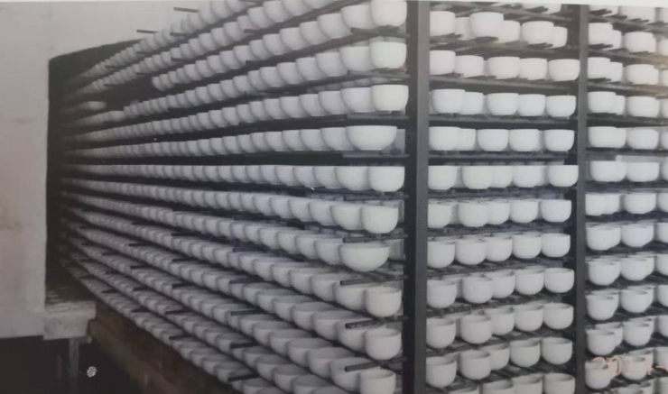
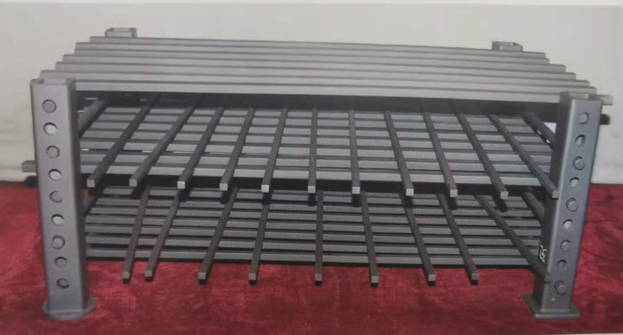
Solid beam pole
日用瓷专用梁、棒
This product is suitable for daily use ceramic kiln bearing structure frame, completely replace the ordinary borosilicate carbide board and Mullite column, increase the product loading capacity, greatly reduce gas, electricity and other energy consumption, shorten the burning time, service life is also several times of other materials, is the most energy saving and consumption reduction of the ideal kiln furniture.
该产品适用于日用陶瓷窑炉的承重结构架，完全替代了普通碳化硅硼板及莫来石立柱，加大了产品的装载容量，大大降低了燃气、电等耗能，缩短了烧成时间，使用寿命也是其他材质的几倍，是目前最节能降耗的理想窑具。
11

Slide 27


Radiant tube and Heat Exchangers
辐射管、换热器
The product has good thermal conductivity, high temperature resistance, corrosion resistance, oxidation resistance, long life and so on.Used for industrial kilns in iron and steel metallurgy industries.
该产品具有良好的热传导性，耐高温、耐腐蚀、抗氧化、寿命长等特点。用于钢铁冶金等行业的工业窑炉。
12

Slide 28


Desulphurization nozzles
脱硫雾化喷嘴
13
The product is the key component of flue gas desulfurization and dust removal unit of thermal power plant and large boiler.It is widely used in desulfurization and dust removal devices of thermal power plants and large boilers.
该产品是火力发电厂、大型锅炉烟气脱硫除尘装置的关键部件。广泛应用于火力电厂和大型锅炉的脱硫除尘装置中。
单项喷嘴/single Direction Nozzles

Slide 29


Desulphurization nozzles
脱硫雾化喷嘴
双向喷嘴/Double Direction Nozzles
螺旋喷嘴/Spiral Nozzles
13

Slide 30

Special Parts
异形件
This product has the characteristics of high strength, high hardness, high wear resistance, high temperature resistance, corrosion resistance, etc., suitable for petrochemical industry, metallurgical manufacturing, aerospace and nuclear industry and other specific environments
该产品具有高强度、高硬度、高耐磨、耐高温、耐腐蚀等特点，适用于石油化工、冶金制造、航空航天以及核工业等特定环境
14

Slide 31
SSiC Properties
常压烧结碳化硅制品性能特点
Atmospheric sintered silicon carbide ceramics is made of high-purity and ultra-fine silicon carbide powder with a small amount of sintering auxiliaries. Sintered at a high temperature of 2000-2200 degrees Celsius in atmospheric inert gas or vacuum atmosphere, the products are compact, bright and clean with excellent performance.Sintered silicon carbide at atmospheric pressure can maintain high strength and corrosion resistance for a long time at high temperature (1600 degrees Celsius), with better thermal shock resistance, thermal conductivity and high wear resistance, its hardness is comparable to diamond.It is an ideal material for manufacturing chemical pump seal ring, shaft sleeve, high-temperature nozzle and ultra-high temperature, ultra-thin kiln furniture.
常压烧结碳化硅陶瓷是以高纯、超细碳化硅粉为原料，加入少量的烧结助剂，在大气压的惰性气体或真空气氛中，2000-2200摄氏度高温下烧结，制品致密、光洁，性能优良。常压烧结碳化硅在高温（1600摄氏度）状态下能长时间保持高强度和耐腐蚀性能，具有更好的抗热震、导热和高耐磨性能，其硬度堪比金刚石。是制造化工泵密封环、轴套、高温喷嘴以及超高温、超薄窑具等产品的理想材料。
15

Slide 32

Bulletproof product profile
防弹产品
Bullet-proof ceramics are characterized by high hardness, low density, low porosity, wear resistance and corrosion resistance, and high stability. They are combined with polymer materials through special process to form ballistic protection products.Compared with other bulletproof products, it has the advantages of light weight, especially replacing the application of steel in the field of bulletproof armor, and improving the operational mobility of individual soldiers and vehicles.The company is committed to the research and development of bulletproof ceramics, manufacturing technology is mature, has acquired a number of intellectual property rights of bulletproof ceramics technology and patented products.
防弹陶瓷具有高硬度、密度小、气孔率低、耐磨耐腐蚀、稳定性高等特点，与高分子材料通过特殊工艺复合，形成弹道防护产品。 相对其它防弹产品具有重量轻等优点，尤其替代钢铁在防弹装甲领域的应用，提高了单兵和车辆的作战机动性。公司致力于防弹陶瓷的研发，制造工艺成熟，获得多项具有知识产权的防弹陶瓷技术和专利产品。
16

Slide 33
Graphite Electrode
04
North China carbon base

Slide 34

Graphite Electrode
石墨电极
Graphite electrode is an important conductive material in electrode electric smelting industry, has the good conductive, thermal conductivity, high mechanical degree, high temperature oxidation resistance, good corrosion resistance, is widely applied to heat boiler, ore smelting electric arc furnace (production of titanium alloy, pure silicon, yellow phosphorus, matte, calcium carbide, etc.), resistance furnace, such as the production of graphite electrode graphitization furnace, melting glass furnace, in the production of silicon carbide furnace), has become an important part of the contemporary industrial raw materials.
Graphite electrode can be divided into ordinary graphite electrode, impregnated graphite electrode, high power graphite electrode and ultra-high power graphite electrode.
石墨电极是电极电冶炼工业中重要的导电材料，具有良好的导电，导热性，机械度高，高温下抗氧化，抗腐蚀性好，广泛应用于电弧炼锅炉、矿热电炉（生产钛合金，纯硅，黄磷、冰铜、电石等）、电阻炉（如生产石墨电极的石墨化炉、熔化玻璃的熔炉、生产碳化硅的电炉），已经成为当代原材料工业的重要组成部分。
石墨电极分普通石墨电极、浸渍石墨电极、高功率石墨电极、超高功率石墨电极

Slide 35






Physical and chemical indexes of ordinary power graphite electrode
普通功率石墨电极 理化指标

Slide 36

Physical and chemical indexes of impregnated graphite electrode
浸渍石墨电极 理化指标

Slide 37

Physical and chemical indexes of high power and high power TYPE II graphite electrodes
高功率和高功率II型石墨电极 理化指标

Slide 38

Physical and chemical indexes of ultra-high power graphite electrode
超高功率石墨电极理化指标

Slide 39

Graphite electrode specification and allowable deviation
石墨电极规格和允许偏差

Slide 40

Graphite electrode recommended current load
石墨电极建议电流负荷

Slide 41



After years of development, we have to train and bring up a batch of young and energetic sales team, based on the principle of win-win cooperation, we set up a global sales network, sales of formed a stable customer base, product sales reached 100%, product throughout the ningxia province city, xinjiang, Inner Mongolia, qinghai, shanxi, shandong, anhui, hubei, sichuan, guizhou, hunan, fujian and other provinces and cities, throughout the United States, the European Union, Japan, Canada, Australia, Brazil, South Africa, UK, India, India, South Korea, southeast Asia and other countries and regions.Products with its excellent quality and excellent value service, won the praise of the majority of customers.
安特利 --- 赢得国际市场
经过多年的发展，我们培养和造就了一批年轻而富有活力的销售队伍，本着合作双赢的原则，我们建立了一套覆盖全球的销售网络，形成了稳定的销售客户群，产品产销率达到了100%，产品遍布宁夏省各地市、新疆、内蒙、青海、山西、山东、安徽、湖北、四川、贵州、湖南、福建等各省市，遍及美国、欧盟、日本、加拿大、澳大利亚、巴西、南非、英国、印度、印度、韩国、东南亚等国家和地区。产品以其过硬的质量和优良超值的服务，赢得了广大客户的赞誉。

Slide 42
Thanks!
2020
Perfect Business Relations

